Slide 1



Identify counterfeit product reviews by bots on E-commerce Platform
Avis Massey
x21199752

Slide 2

Importance of Detecting False Reviews
Enhance Customer Trust.
Protects Consumers
Preserves Brand Reputation
2

Slide 3
Types of Fake Product Reviews and How to Identify Them
PAID
BOT
AI-Generated
Sockpuppet
Self-Branding

Slide 4


How to detect and identify counterfeit product reviews authored by automated bots on ecommerce platforms by utilizing various machine learning techniques and methodologies?
RESEARCH
QUESTION

Slide 5
- CRISP-DM - Business Understanding - Data Understanding - Data Processing and Modelling - Evaluation - Deployment
Methodology
5

Slide 6
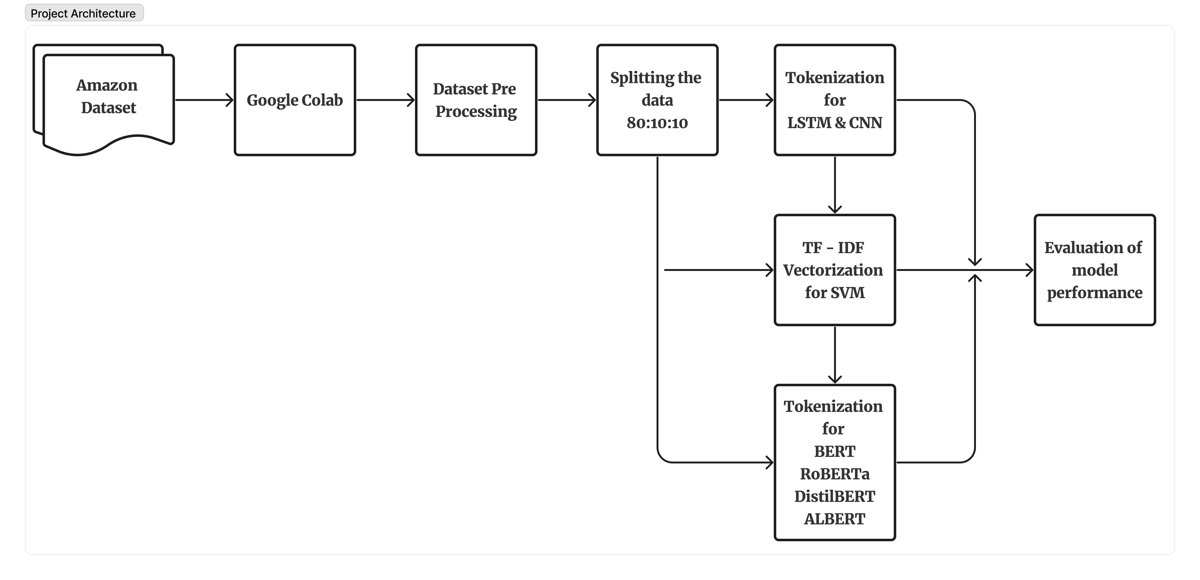
Design Specification
6

Slide 7
Implementation of Machine Learnining Models
LSTM
CNN
BERT
ALBERT
SVM
DistilBERT
RoBERTa

Slide 8
Codeartifact

Slide 9
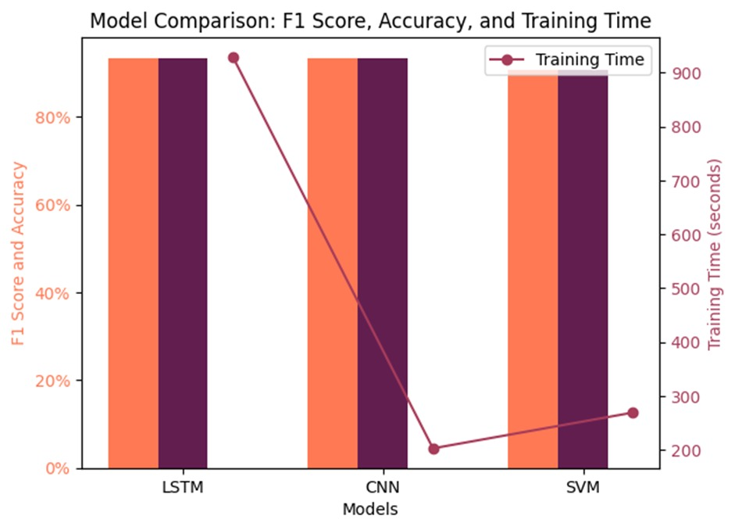
LSTM vs CNN vs SVM
Model Evaluation
9

Slide 10
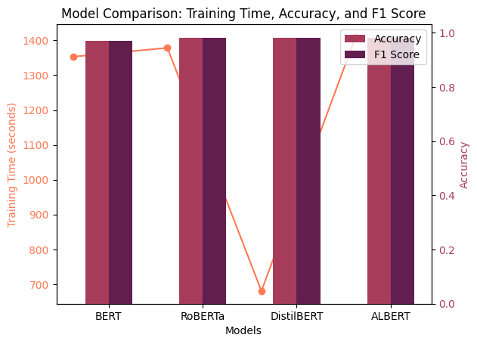
BERT vs RoBERTa vs DistilBERT vs ALBERT
Model Evaluation
10

Slide 11
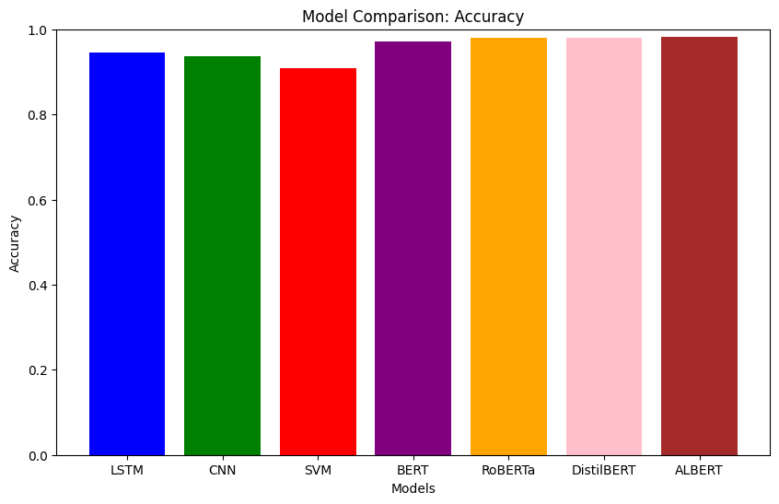
ALL Models
Model Evaluation
11

Slide 12

Conclusion
DistilBERT out performed all the models considering the performance metrics of accuracy – 93%, F1- score – 0.93 and computation time – 680 secs.
12

Slide 13




Thank you
Avis Massey
x21199752

